Slide 1

Shared-Memory Parallelism: CPUs, GPUs and in-between
Dr. Gal Oren
Teaching Assistant: Yehonatan Fridman
winter 2022-2023

Slide 2

Intel OneAPI
The Intel® oneAPI Base Toolkit (Base Kit) is a core set of tools and libraries for developing high-performance, data-centric applications across diverse architectures. It features an industry-leading C++ compiler that implements SYCL*, an evolution of C++ for heterogeneous computing.
You can complement the Base Kit with additional toolkits. For example, the Intel® oneAPI HPC Toolkit includes award-winning Intel® Fortran Compilers, OpenMP* GPU offload, and scalability with message passing interface (MPI).

Slide 3
Intel OneAPI
Intel oneAPI Base Toolkit
General Compute
Intel® oneAPI Collective Communications Library
Intel® oneAPI Data Analytics Library
Intel® oneAPI Deep Neural Networks Library
Intel® oneAPI DPC++/C++ Compiler
Intel® oneAPI DPC++ Library
Intel® oneAPI Math Kernel Library
Intel® oneAPI Threading Building Blocks
Intel® oneAPI Video Processing Library
Intel® Advisor
Intel® Distribution for GDB*
Intel® Distribution for Python*
Intel® DPC++ Compatibility Tool
Intel® FPGA Add-on for oneAPI Base Toolkit
Intel® Integrated Performance Primitives
Intel® VTune™ Profiler
Intel oneAPI HPC Toolkit
High-Performance Computing
This toolkit complements the Intel® oneAPI Base Toolkit and includes:
Intel oneAPI DPC++/C++ Compiler
Intel® C++ Compiler Classic
Intel® Cluster Checker
Intel® Fortran Compiler
Intel® Fortran Compiler Classic
Intel® Inspector
Intel® MPI Library
Intel® Trace Analyzer and Collector

Slide 4

Intel OneAPI
https://www.linkedin.com/groups/9233356/

Slide 5
Administrations
3-4 homework assignments (30%), individually or in pairs.
Competitive Project (70%), individually.
Attendance is highly recommended!
Dr. Gal Oren - galoren@technion.ac.il
Teaching Assistant: Yehonatan Fridman - f.yehonatan@technion.ac.il

Slide 6
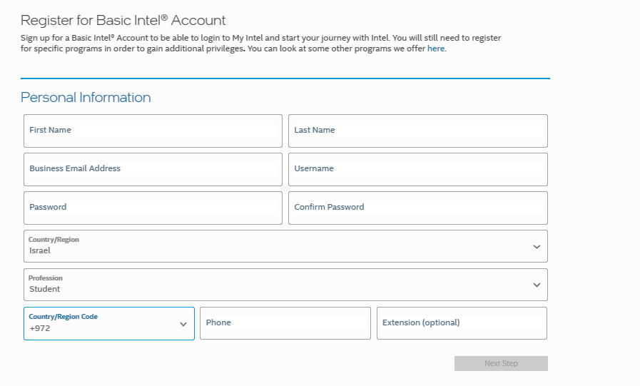
Accessing Intel® DevCloud
Step 1: Create your Intel account
Click on this link below:
https://www.intel.com/content/www/us/en/forms/basic-intel-registration.html
Please use your Technion Email ID (Ex: Israel Israeli Israeli.israel@campus.technion.ac.il )
If you already have an account, Sign in, else Register and then Sign in before going to Step 2 (next slide)

Slide 7
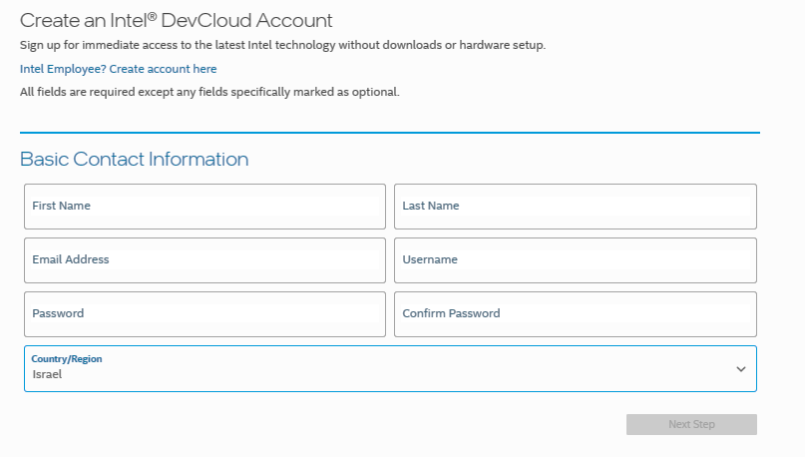
Accessing Intel® DevCloud
Step 2: Register for Intel® DevCloud
Click on this link below:
https://www.intel.com/content/www/us/en/forms/idz/devcloud-registration.html?tgt=https://www.intel.com/content/www/us/en/secure/forms/devcloud-enrollment/account-provisioning.html&eventcode=TECHNIONSEPONEAPI
If you already have an account, Sign in, else Register and then Sign in before going to Step 2 (next slide)

Slide 8
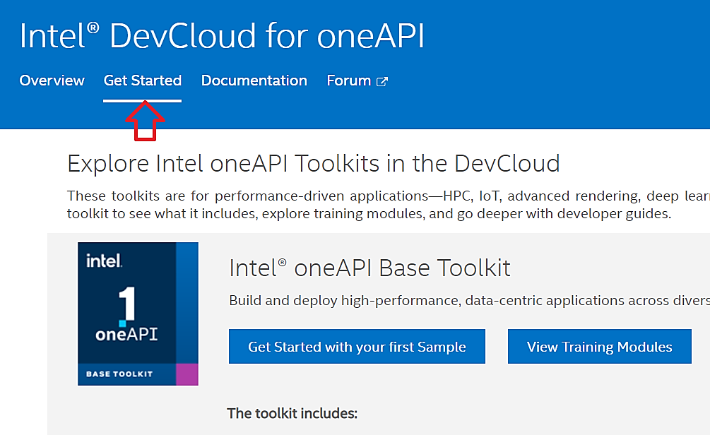
Connect with Jupyter Lab
Click on ‘Get Started’ button
https://devcloud.intel.com/oneapi/get_started/

Slide 9
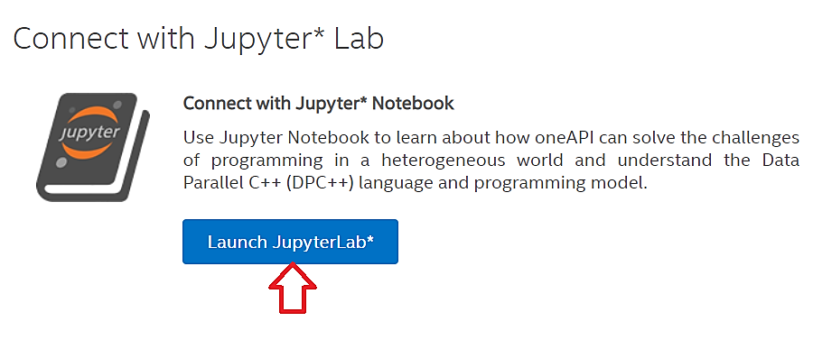
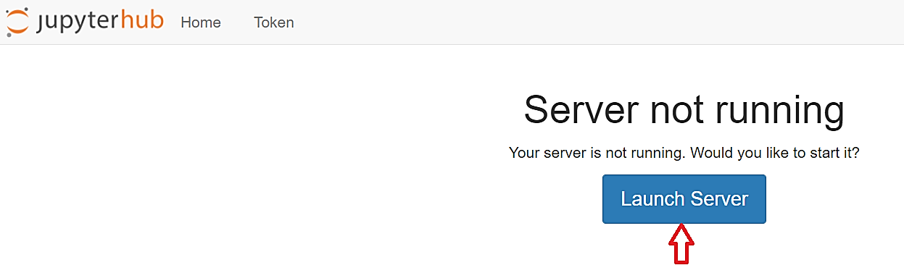
Connect with Jupyter Lab
Scroll down to the bottom of the page and click on ‘Launch JupyterLab’
Click on Launch Server

Slide 10
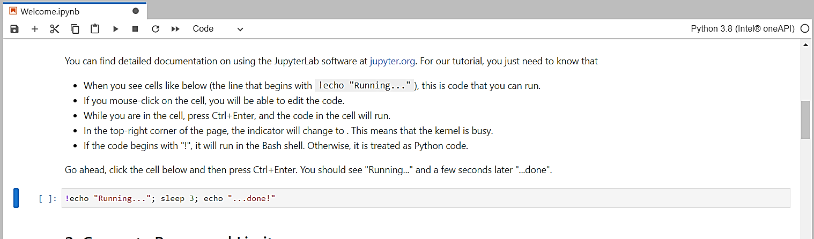
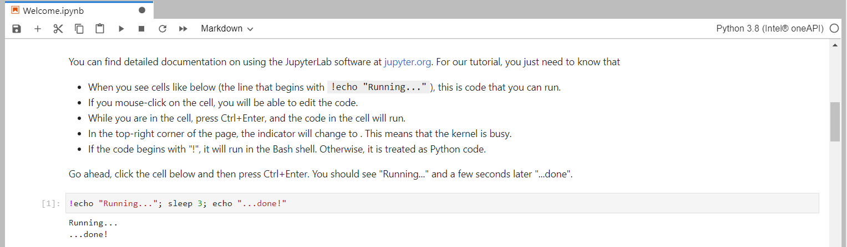
Jupyter notebooks

Slide 11
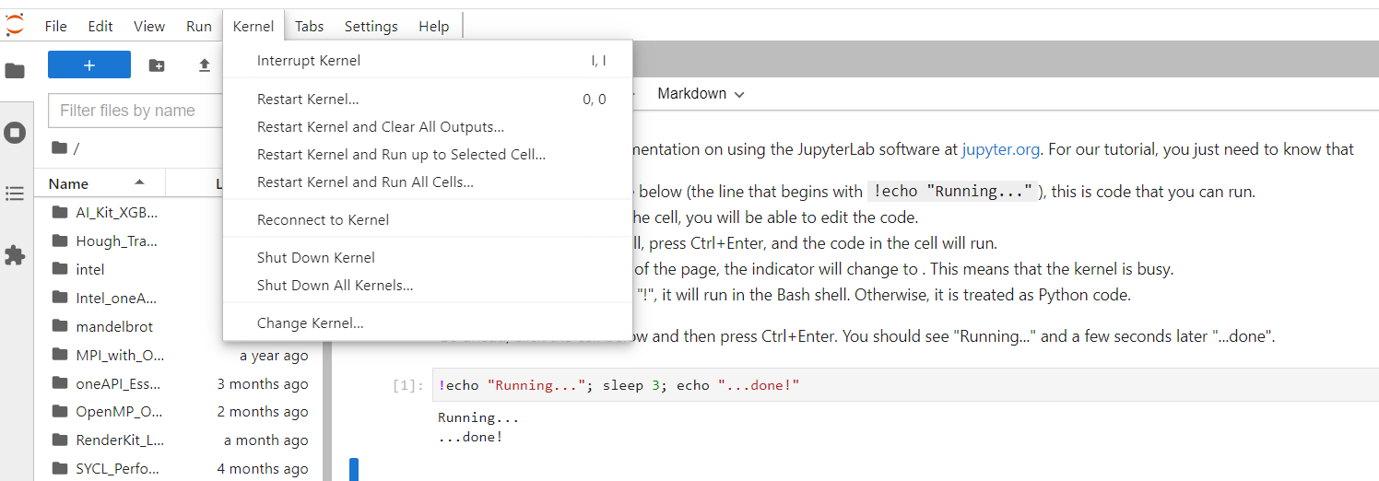
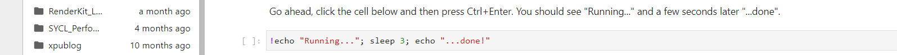
Jupyter notebooks
Kernel options (restart, reconnect…):

Slide 12



HW submission == Jupyter notebooks

Slide 13
PBS (Portable Batch System)
The Portable Batch System (PBS) system is designed to manage the distribution of batch jobs and interactive sessions across the available nodes in the cluster.
The following web page provides an introduction to basic PBS usage:
https://albertsk.files.wordpress.com/2011/12/pbs.pdf

Slide 14
Your Favorite commands (in red)
Job Status:
$ qstat – lists your jobs
$ qdel – If a job is hung (qdel <job id>)
$ pbsnodes –l free
$ clinfo – l (or lists)
Go interactive:
$ qsub –I
$ qsub -I -l nodes=1:gpu:ppn=2
$ clinfo – l (or lists)
$ exit – exit from interactive mode

Slide 15

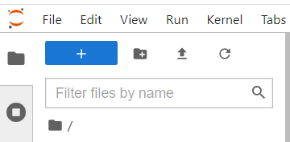
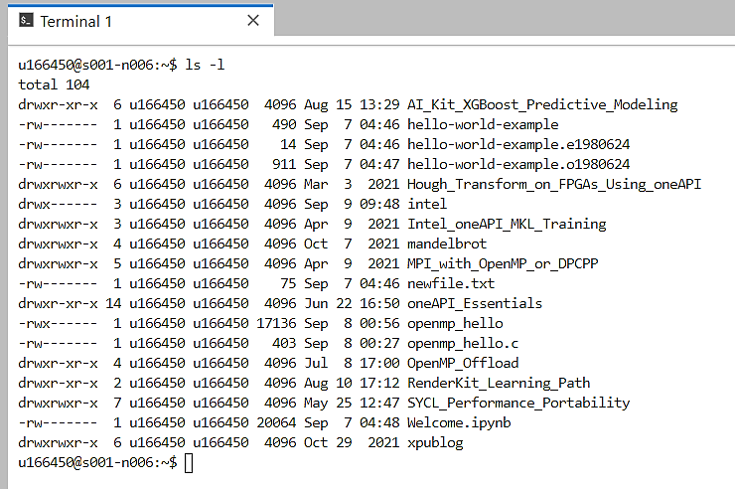
Basic commands – examples

Slide 16
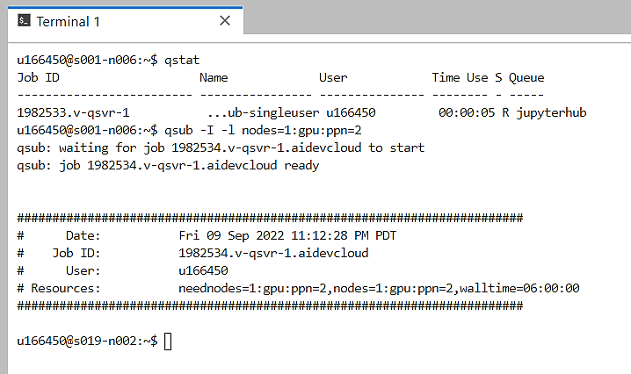
Basic commands – examples
once you submit a job to a compute node using the qsub command, you are allocated a dedicated node and other people cannot access the node until your job completes.
we entered interactively into a node with a GPU device

Slide 17
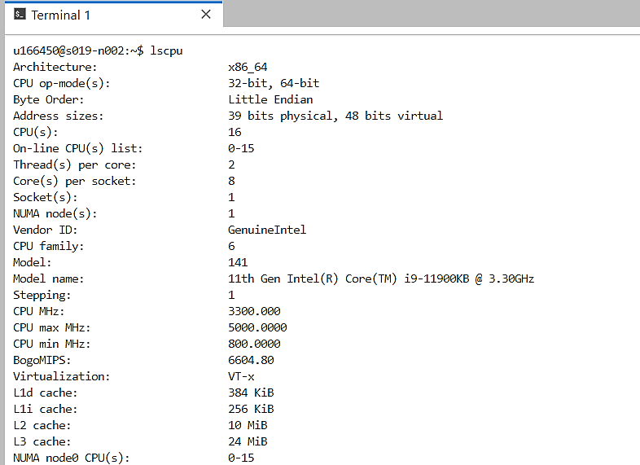
Node specifications

Slide 18
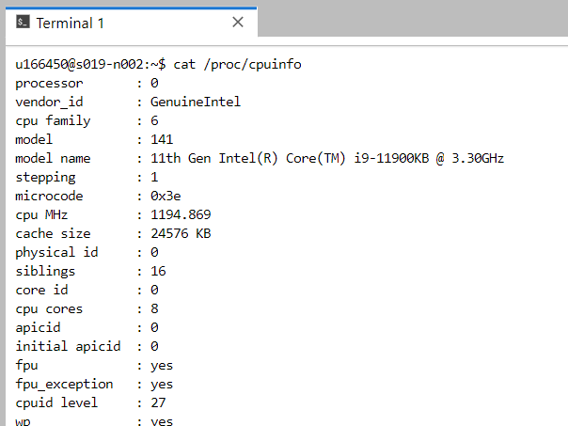
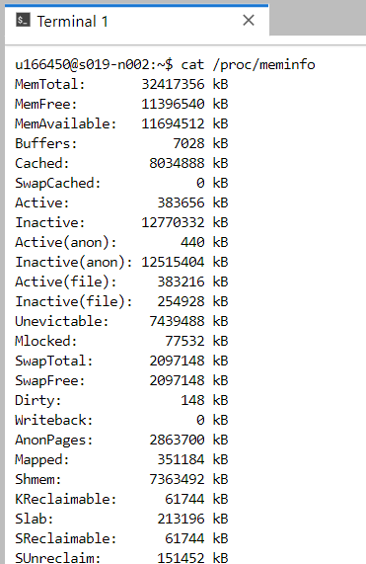
Node specifications

Slide 19
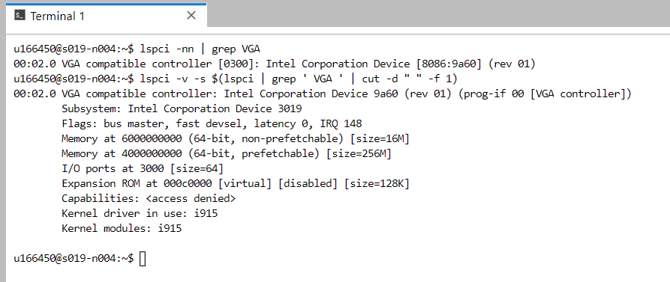
GPU node specifications
run within a GPU node:

Slide 20
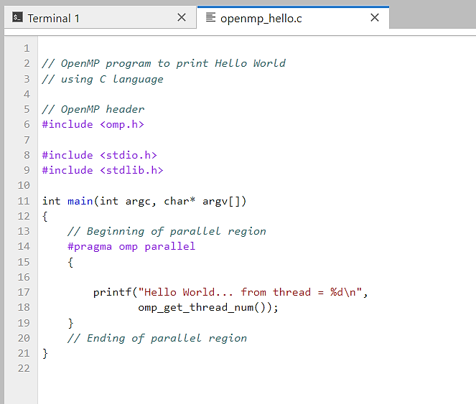
‘Hello World’ with OpenMP

Slide 21
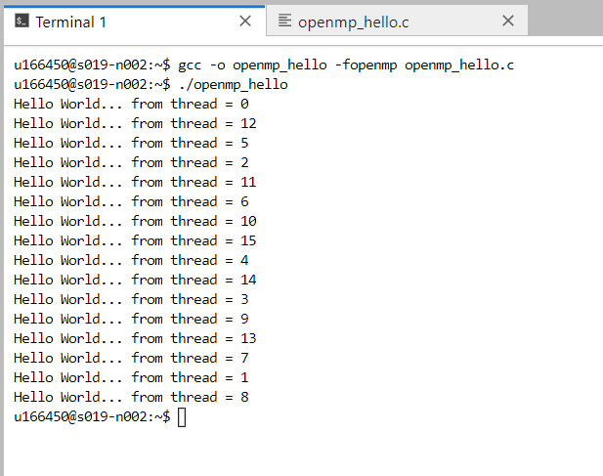
‘Hello World’ with OpenMP

Slide 22
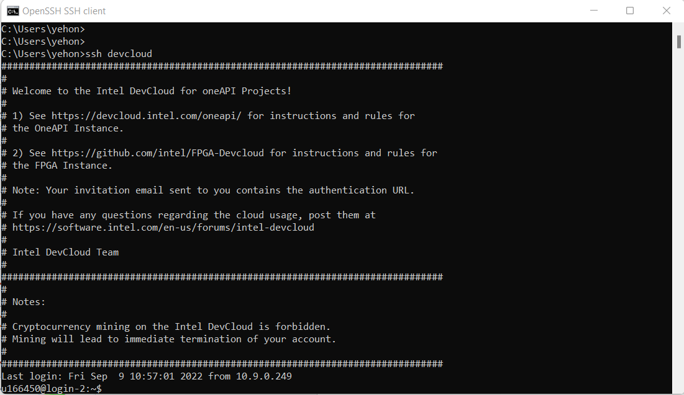
Intel DevCloud: Connect with SSH
Connect to Intel® DevCloud via SSH from your local machine:
for windows:
https://devcloud.intel.com/oneapi/documentation/connect-with-ssh-windows-cygwin/
for Linux of MacOS:
https://devcloud.intel.com/oneapi/documentation/connect-with-ssh-linux-macos/

Slide 23
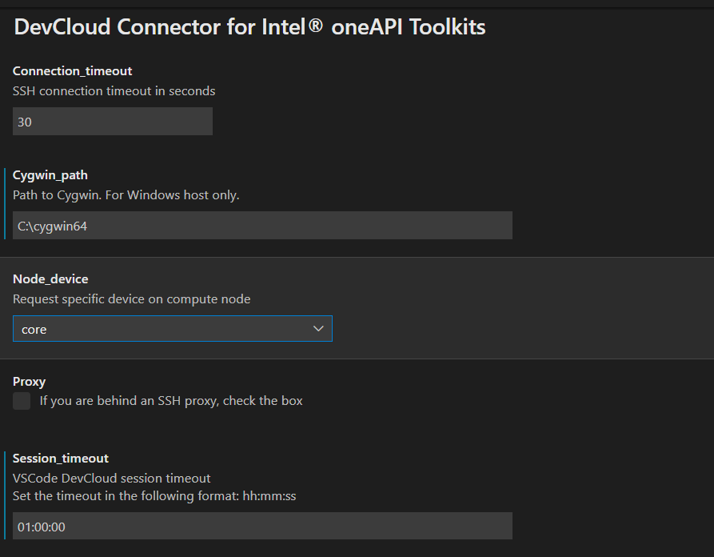
Intel DevCloud: Connect with VS Code
You might find it comfortable to connect to Intel® DevCloud with Visual Studio Code. Follow the instructions:
https://devcloud.intel.com/oneapi/documentation/connect-with-vscode/

Slide 24
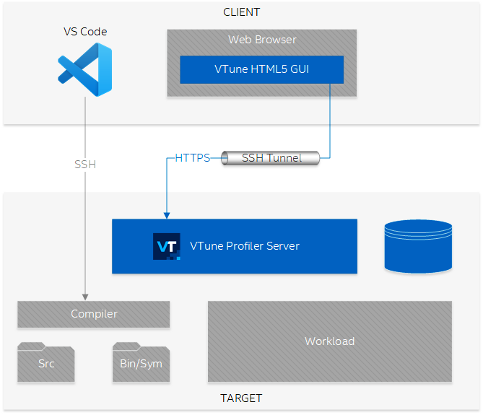
Intel® VTune™ profiler
Performance Analysis for Applications & Systems
https://www.intel.com/content/www/us/en/develop/documentation/vtune-cookbook/top/configuration-recipes/using-vtune-server-with-vs-code-intel-devcloud.html
VTune profiler can run as a server and be accessed on client side via VS code or SSH Tunneling.

Slide 25
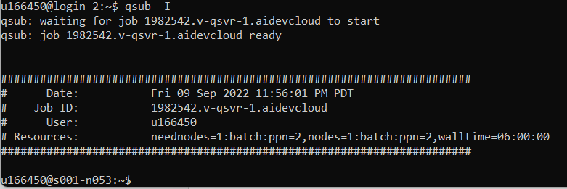
Intel® VTune™ profiler
We now see how to access VTune via SSH Tunneling:
https://www.intel.com/content/www/us/en/develop/documentation/vtune-cookbook/top/configuration-recipes/using-vtune-server-with-vs-code-intel-devcloud.html#using-vtune-server-with-vs-code-intel-devcloud_FINISH
we connect to devcloud with SSH and allocate a compute node:
We do not close this terminal, as the action will release our compute node

Slide 26
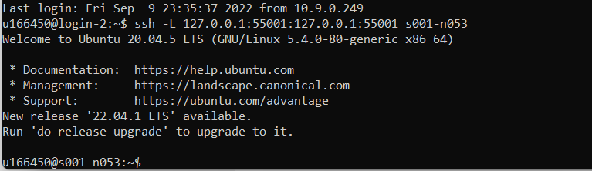
Intel® VTune™ profiler
We now see how to access VTune via SSH Tunneling:
on another terminal, we set up an SSH tunneling:

Slide 27
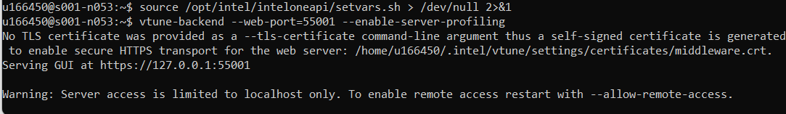

Intel® VTune™ profiler
We now see how to access VTune via SSH Tunneling:
and we run VTune backend:
then we open a browser on our local machine:
when you open VTune for the first time, it is recommended to follow the onboarding guide!

Slide 28
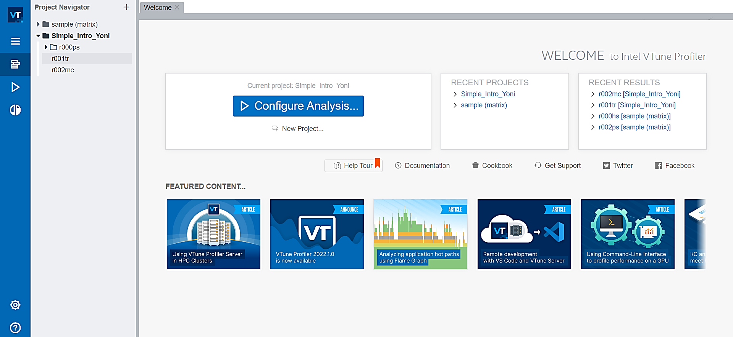
Intel® VTune™ profiler
we create a new project or select an existing project, then click on ‘Configure Analysis’:

Slide 29
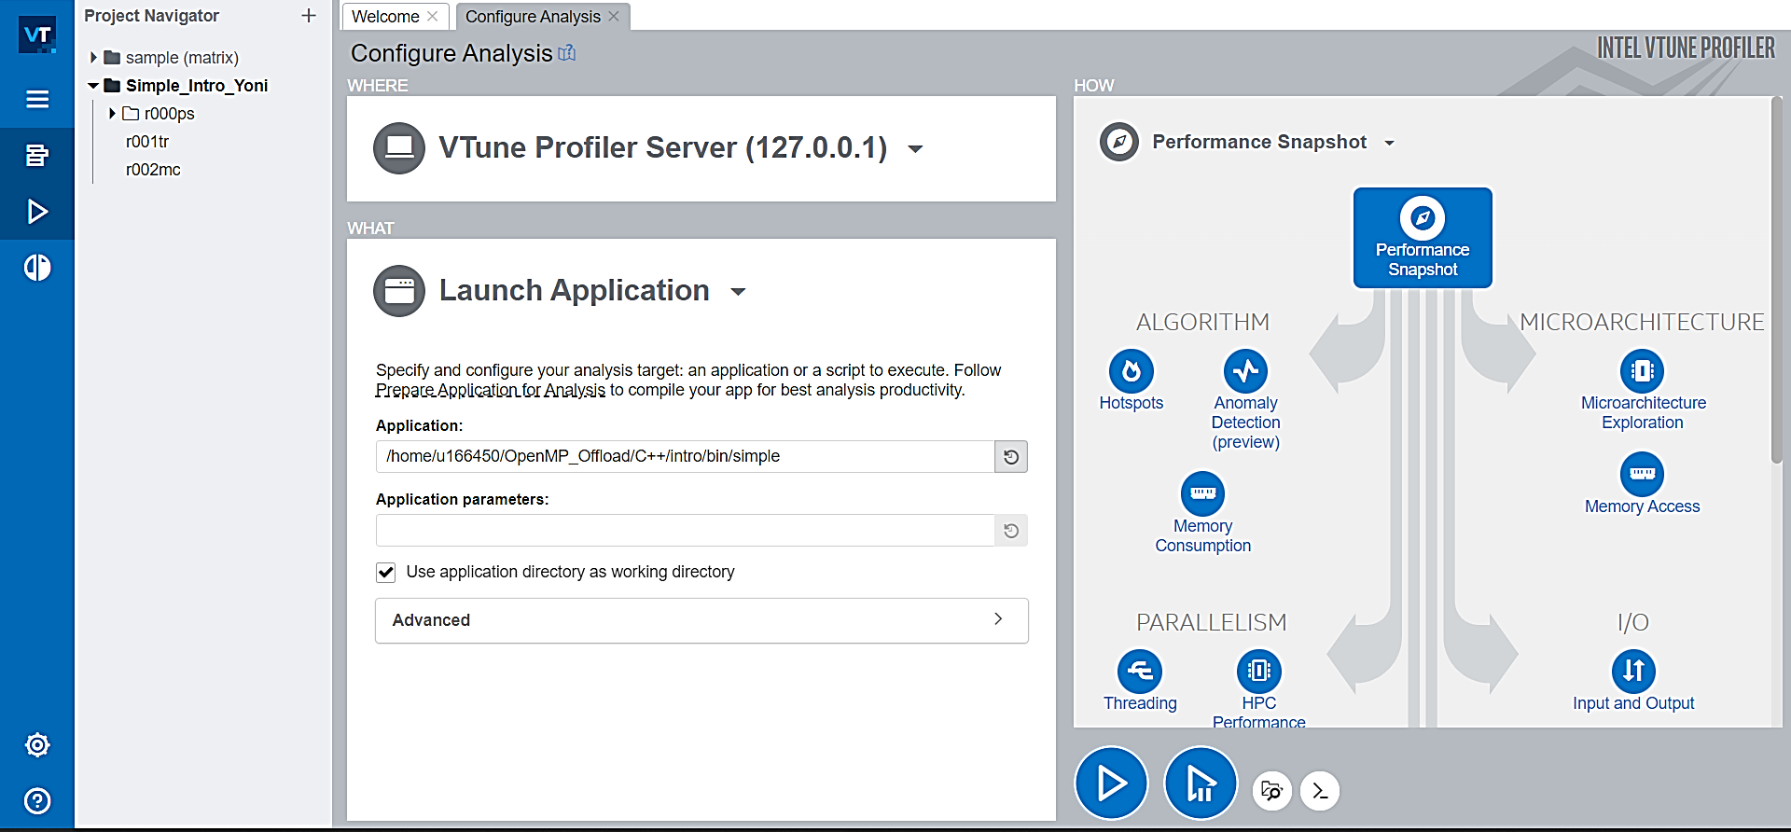
Intel® VTune™ profiler
we choose application and the desire analysis, then ‘play’:
results of analysis are saved under the project directory

Slide 30
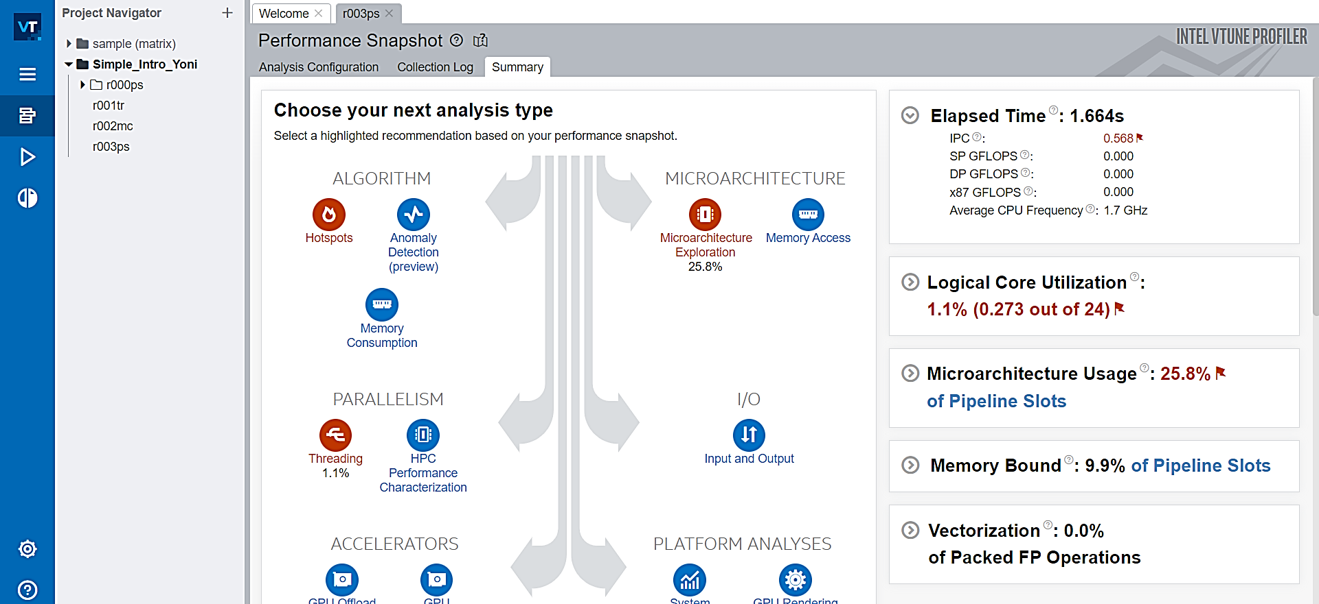
Intel® VTune™ profiler
Example – Performance Snapshot result:

Slide 31
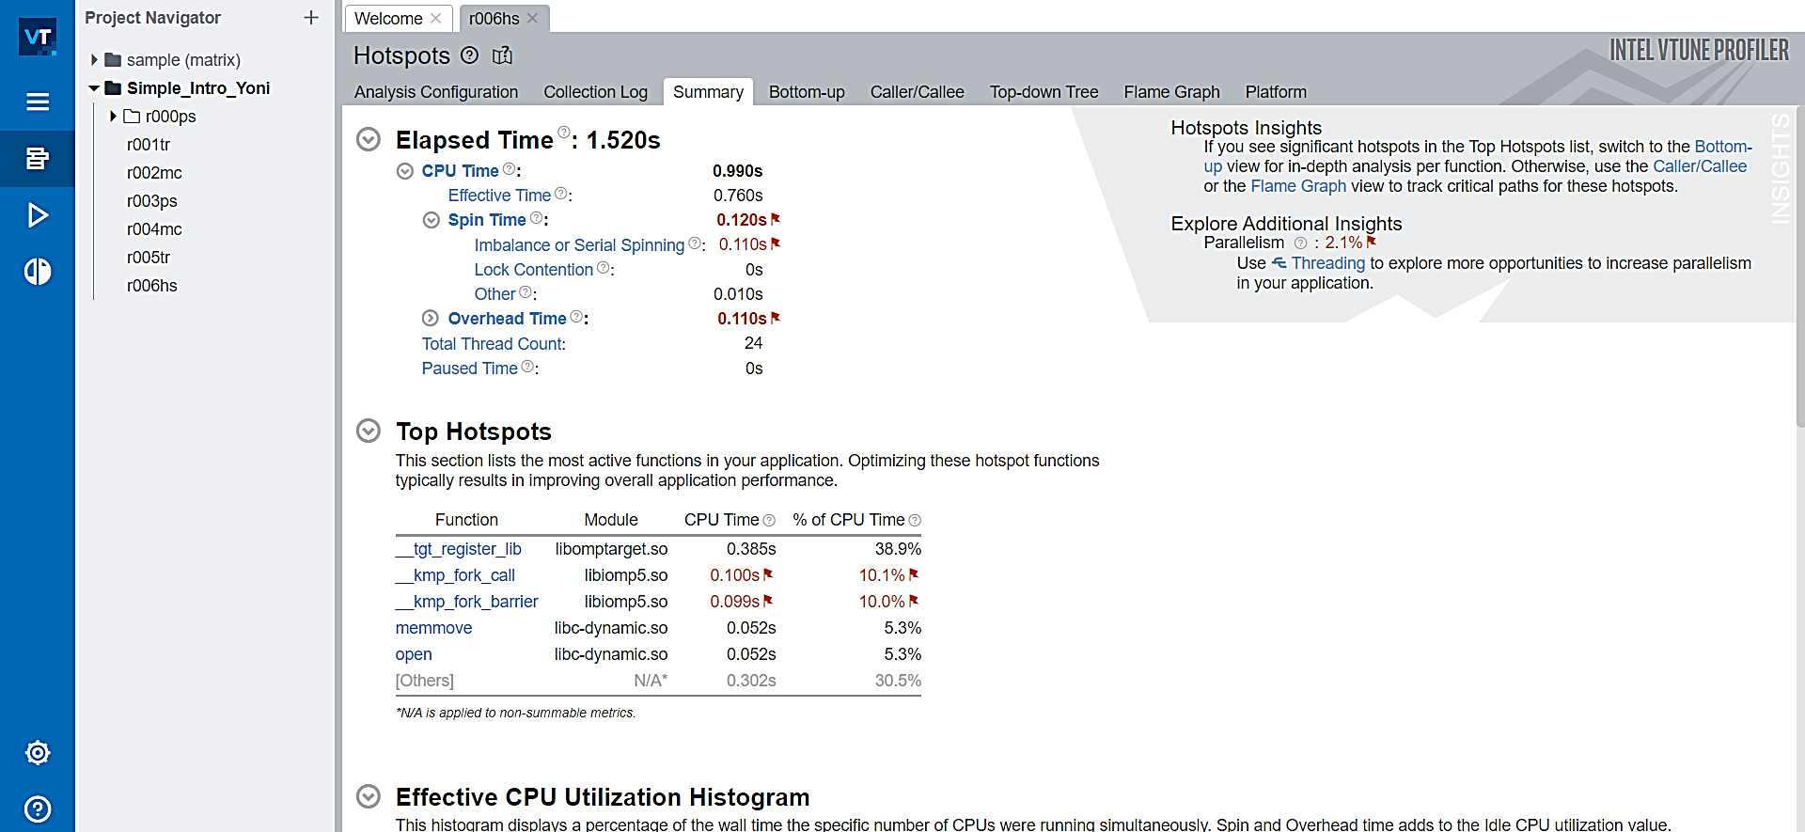
Intel® VTune™ profiler
Another example – Hotspots analysis:

Slide 32
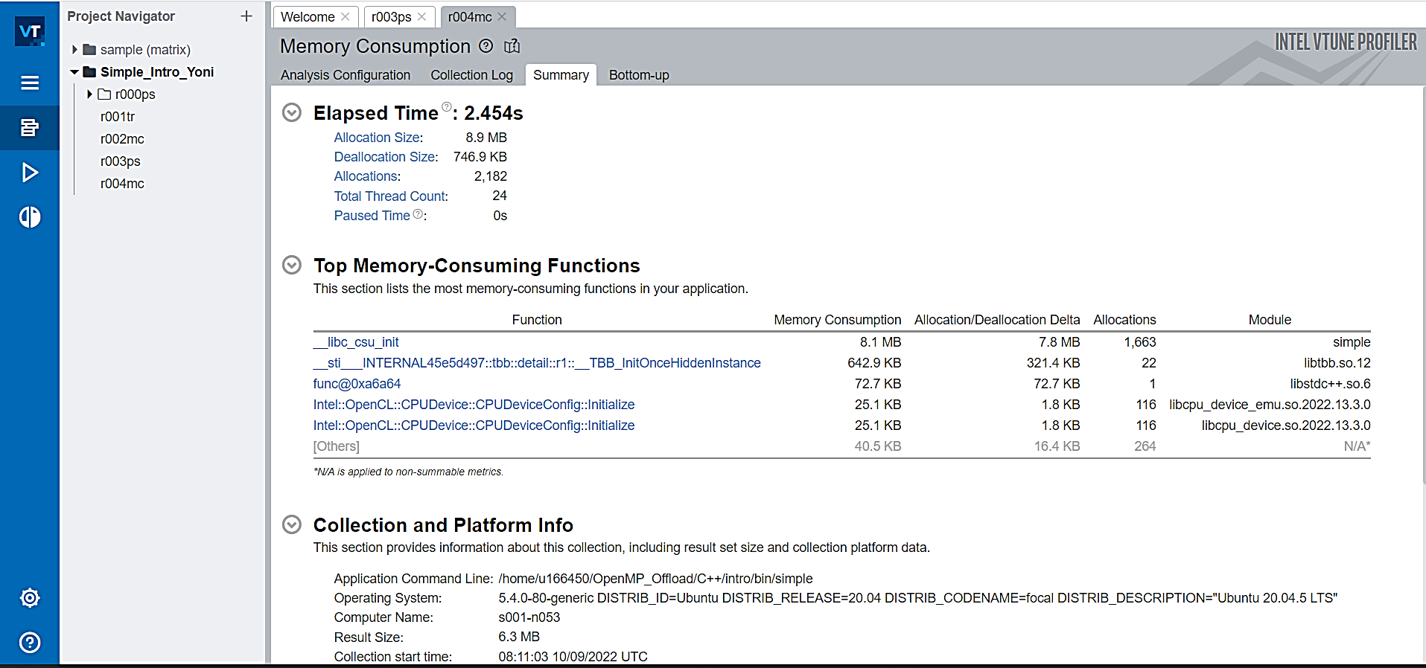
Intel® VTune™ profiler
Another example – Memory Consumption result:

Slide 33
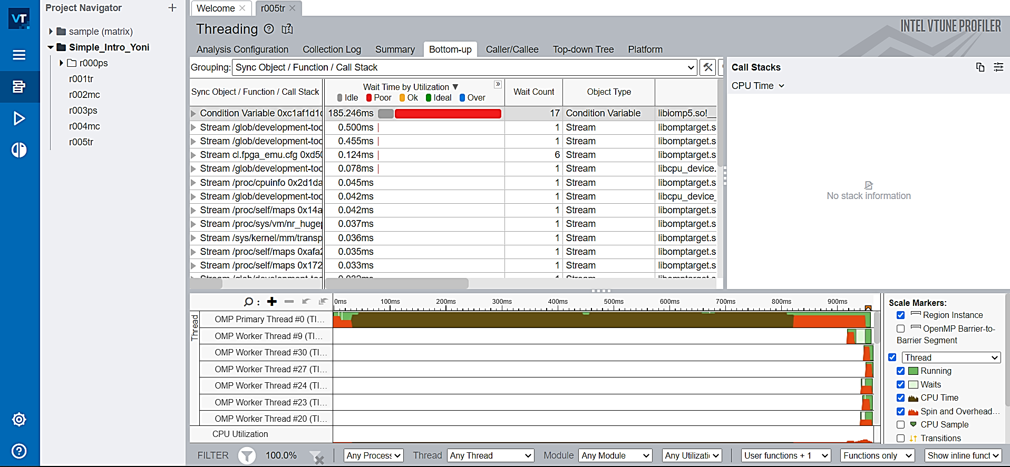
Intel® VTune™ profiler
Another example – Threading information:

